Slide 1
Capstone Project – 3 Mobile Price Range Prediction Presented By Aniket Abhit Jadhav

Slide 2

Let’s Catch The Defaulters
Defining problem statement
EDA and feature engineering
Feature Selection
Preparing dataset for modeling
Applying Model
Model Validation and Selection

Slide 3

The Dilemma
I use historical data to identify which phone features and specifications contribute to a higher or lower price range. By analyzing the data, I will create a predictive model that can identify which mobile phone models are relatively expensive or inexpensive.
To achieve this, I will break down the project into four parts. The first part is data collection, where I will gather relevant data on various mobile phone models and their corresponding prices. This data will include factors such as the phone's brand, processor, camera quality, storage capacity, and screen size.
The second part of the project is data cleaning, where I will remove any inconsistencies or errors in the data to ensure the model's accuracy. I will also transform the data into a format that is easy for the model to use.

Slide 4
The third part of the project is feature selection, where I will determine which factors have the most significant impact on a mobile phone's price range. By analyzing the data, I will identify which features are correlated with higher or lower prices and use them as inputs for the predictive model.
The fourth and final part of the project is model training, where I will use machine learning algorithms to develop a predictive model that can accurately predict mobile phone prices based on their features and specifications. This model will be trained on the historical data and tested on new data to ensure its accuracy and reliability.
With this predictive model, potential buyers can use the phone's specifications to estimate the price range they should expect to pay. Additionally, mobile phone manufacturers and sellers can use this model to price their products competitively and increase their sales.

Slide 5
With this predictive model, potential buyers can use the phone's specifications to estimate the price range they should expect to pay. Additionally, mobile phone manufacturers and sellers can use this model to price their products competitively and increase their sales.

Slide 6
Data Pipeline
Data processing-1: In this first part we’ve removed unnecessary features.
Since there were nearly many columns with all null values.
Data processing-2: In this part, we manually go through each features selected from part 1, And encoded the categorical features ,changed the columns containing date time values .
EDA: In in this part, we do some exploratory data analysis (EDA) on the features selected in part-1 and 2 to see the trend.
Create a model: Finally, In this last but not the last part, we create models. Creating a model is also not an easy task. It’s also an iterative process. we show how to start with a with a simple model, then slowly add complexity for better performance.

Slide 7

Data Summary

Slide 8
Data Summary
Battery_power - Total energy a battery can store in one time measured in mAh.
Blue - Has bluetooth or not.
Clock_speed - speed at which microprocessor executes instructions.
Dual_sim - Has dual sim support or not.
Fc - Front Camera mega pixels.

Slide 9
Data Summary
Four_g - Has 4G or not.
Int_memory - Internal Memory in Gigabytes.
M_dep - Mobile Depth in cm.
Mobile_wt - Weight of mobile phone.
N_cores - Number of cores of processor.

Slide 10
Data Summary
Pc - Primary Camera mega pixels.
Px_height - Pixel Resolution Height.
Px_width - Pixel Resolution Width.
Ram - Random Access Memory in Mega.
Touch_screen - Has touch screen or not.
Wifi - Has wifi or not.

Slide 11
Data Summary
Sc_h - Screen Height of mobile in cm.
Sc_w - Screen Width of mobile in cm.
Talk_time - longest time that a single battery charge will last when you are.
Three_g - Has 3G or not.
Wifi - Has wifi or not.
Price_range - This is the target variable with value of 0(low cost), 1(medium cost),2(High Cost),3(Very High cost).

Slide 12
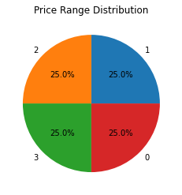
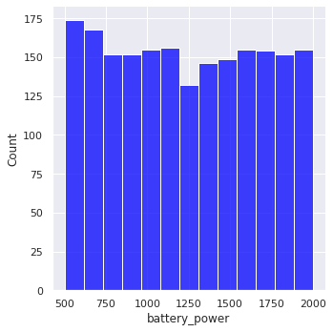
EDA
1.All category phones are distributed with equal price range
2.This plot visualizes how the battery capacity, measured in mAh, is distributed across the dataset. We can observe that the distribution of battery capacity is positively correlated with the price range of the mobile phones, as there is a gradual increase in the battery capacity as the price range increases. This suggests that there is a strong relationship between the battery capacity and the price of a mobile phone, and that consumers may be willing to pay more for a mobile phone with a higher battery capacity.

Slide 13
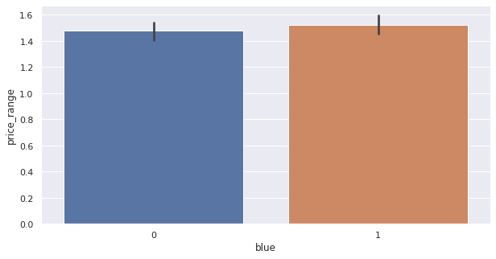
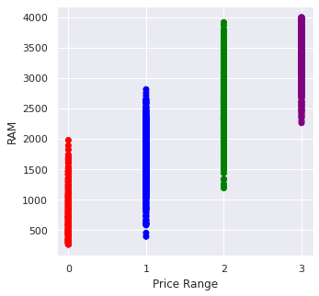
1.Almost half the devices have Bluetooth, and half don’t.
2.The scatter plot shows a clear positive correlation between RAM and price range, with the majority of the data points clustering towards the upper right corner. This suggests that as the price range increases, the amount of RAM in the device generally increases as well.

Slide 14
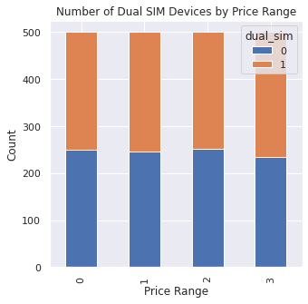
We can observe that upto low , medium , high almost it is same but for very high price range it is seen that it is found that the count is raised who using dual devices and count is increasing for dual devices.

Slide 15
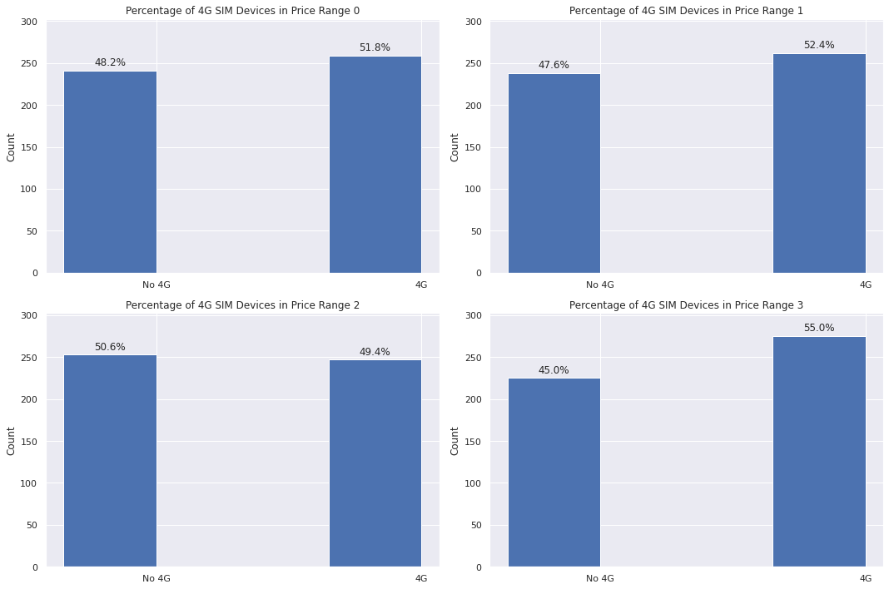
I have found that at low, medium,very high prices the mobile phones having sim in more numbers but at high prices it is showing slightly collapse.

Slide 16
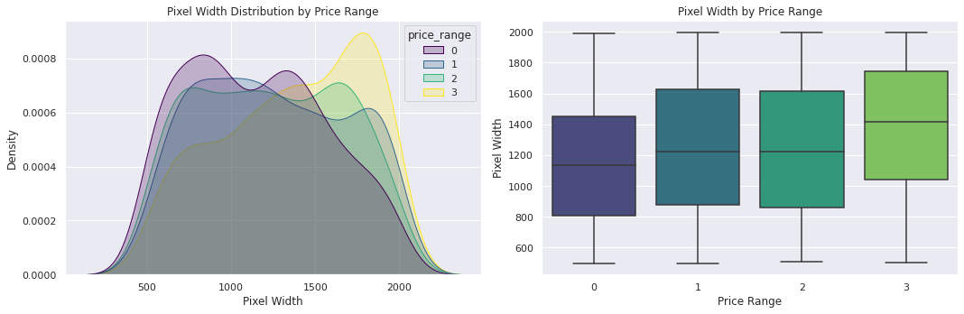

Slide 17
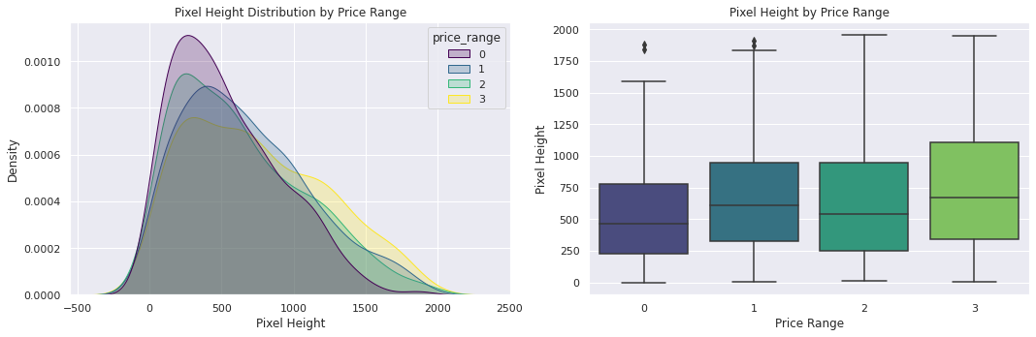
Futuristic Features
Based on the analysis of the pixel width distribution across different price ranges, it can be observed that there is not a continuous increase in pixel width as we move from low cost to very high cost mobile phones. In particular, mobile phones with medium cost and high cost have almost equal pixel width, indicating that this may not be the sole driving factor in deciding the price range of mobile phones. Other features such as processor, camera quality, storage capacity, and brand value may also play a significant role in determining the price range. Therefore, a holistic approach considering multiple factors is necessary for accurate pricing and positioning of mobile phones in the market . Pixel height is almost similar as we move from Low cost to Very high cost . little variation in pixel_height.

Slide 18
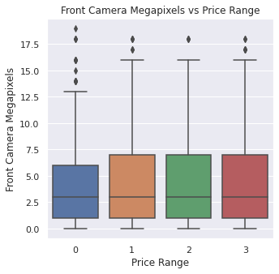
EDA
It is almost same impcact of price range in all categories.

Slide 19
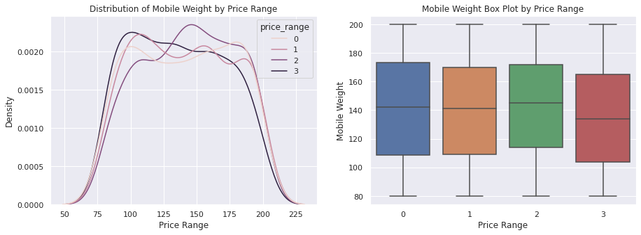
EDA (continued)
The distribution of primary camera megapixels across different target categories is relatively consistent, indicating that this feature may not significantly influence the price range of mobile phones. This consistency is a positive sign for prediction modeling, as it suggests that this feature may not be a major confounding factor in predicting the price range.

Slide 20
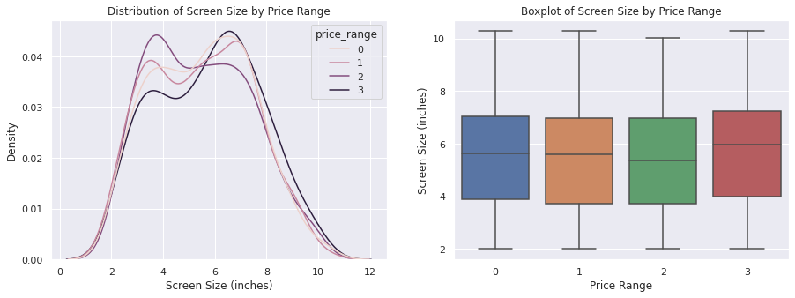
EDA (continued)
It can be observed that mobile phones with higher price ranges tend to be lighter in weight compared to lower price range phones.

Slide 21
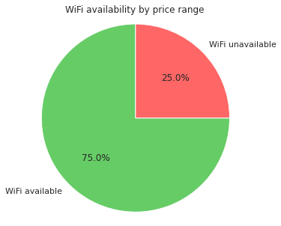
EDA (continued)
Around in 25% the wifi is not available and in 75% the wifi is availa

Slide 22
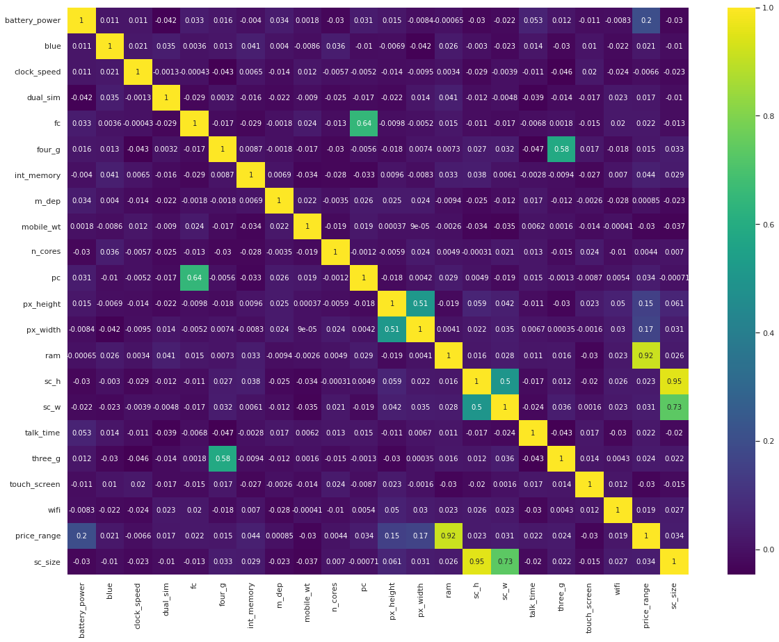
EDA (continued)

Slide 23
The high correlation between RAM and price_range is a positive sign for businesses as it indicates that RAM will be a major deciding factor in estimating the price range of a mobile phone.
However, there are also some cases of collinearity in the data. Specifically, there is a correlation between the pairs of features ('pc', 'fc') and ('px_width', 'px_height'). These correlations make sense, as a phone with a good front camera is likely to have a good back camera, and an increase in pixel height typically corresponds with an increase in pixel width.

Slide 24
To address this collinearity, we could consider replacing the 'px_height' and 'px_width' features with a single feature representing the overall number of pixels in the screen. However, it is important to note that the 'fc' and 'pc' features should be kept separate, as they represent different aspects of the phone's camera capabilities (front camera megapixels vs. primary camera megapixels).

Slide 25
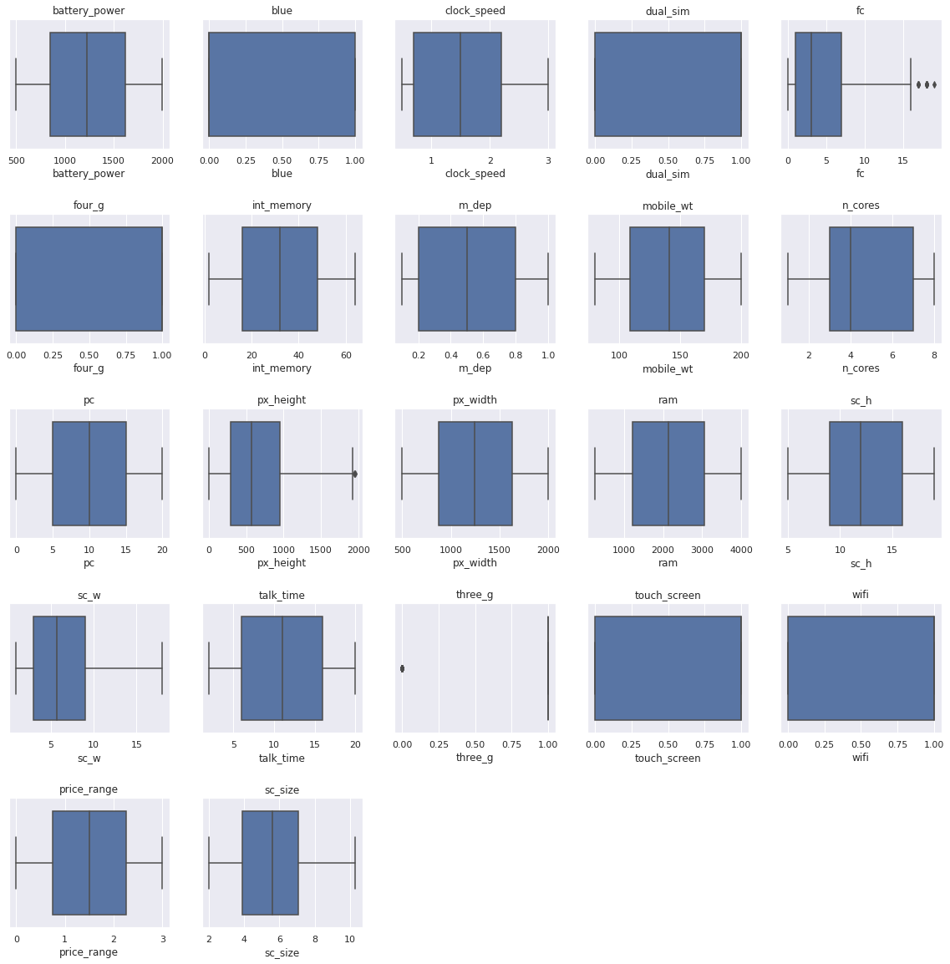
Outliers Handling
hhhchchhhx
As we can see very less outliers are present so no need to remove

Slide 26
Model Implementation : Logistic Regression
Test set :
Classification report for Logistic Regression (Test set)=
precision recall f1-score support
0 0.91 0.90 0.91 107
1 0.69 0.76 0.72 83
2 0.68 0.65 0.67 97
3 0.85 0.84 0.84 113
Accuracy : 0.79 400
Macro avg : 0.78 0.79 0.79 400
Weighted avg : 0.79 0.79 0.79 400

Slide 27
Train set :
Classification report for Logistic Regression (Train set)=
precision recall f1-score support
0 0.93 0.88 0.90 421
1 0.75 0.79 0.77 386
2 0.73 0.79 0.76 379
3 0.92 0.86 0.89 414
Accuracy : 0.83 1600
Macro avg : 0.83 0.83 0.83 1600
Weighted avg : 0.84 0.83 0.83 1600
Cross-validation scores: [0.81 0.825 0.8375 0.81 0.8125]
Average cross-validation score: 0.8190000000000002

Slide 28
Xgboost :
Test set :
Classification Report for XGBoost(Test set)=
precision recall f1-score support
0 0.91 0.91 0.91 105
1 0.77 0.77 0.77 91
2 0.66 0.76 0.71 92
3 0.90 0.78 0.83 112
Accuracy : 0.81 400
Macro avg : 0.81 0.81 0.80 400
Weighted avg : 0.82 0.81 0.81 400

Slide 29
Train set
Classification Report for XGBoost(Train set)=
precision recall f1-score support
0 0.99 1.00 0.99 395
1 0.99 0.98 0.99 409
2 0.99 0.99 0.99 408
3 1.00 1.00 1.00 388
Accuracy : 0.99 1600
Macro avg : 0.99 0.99 0.99 1600
Weighted avg : 0.99 0.99 0.99 1600

Slide 30
Cross-validation score: 0.8150000000000001
Classification Report for XGBoost(Test set)=
precision recall f1-score support
0 0.91 0.93 0.92 105
1 0.76 0.76 0.76 91
2 0.66 0.72 0.69 92
3 0.89 0.80 0.85 112
Accuracy : 0.81 400
Macro avg : 0.80 0.80 0.80 400
Weighted avg : 0.81 0.81 0.81 40

Slide 31
Random Forest Classifier :
Test set :
precision recall f1-score support
0 0.92 0.94 0.93 105
1 0.78 0.75 0.76 91
2 0.63 0.72 0.67 92
3 0.87 0.78 0.82 112
Accuracy : 0.80 400
Macro avg : 0.80 0.80 0.80 400
Weighted avg : 0.81 0.80 0.80 400

Slide 32
Train set:
precision recall f1-score support
0 0.89 0.96 0.93 105
1 0.80 0.73 0.76 91
2 0.64 0.71 0.67 92
3 0.86 0.79 0.83 112
accuracy 0.80 400
macro avg 0.80 0.80 0.80 400
weighted avg 0.81 0.80 0.80 400

Slide 33
Conclusion
Based on the exploratory data analysis (EDA), we observed that the mobile phones in the dataset are divided into four different price ranges, each having a similar number of elements. Additionally, we found that approximately half of the devices have Bluetooth, while the other half do not. Furthermore, we noted that as the price range increases, there is a gradual increase in battery power, and RAM shows continuous growth from low-cost to very high-cost phones. Moreover, the costly phones tend to be lighter than the lower-priced ones.
Our analysis indicates that RAM, battery power, and pixel quality are the most significant factors affecting the price range of mobile phones. From our experiments, we concluded that logistic regression and XGBoost algorithms with hyperparameter tuning yielded the best results in predicting the price range of mobile phones.

Slide 34
In summary, the EDA revealed that the dataset consists of mobile phones grouped into four price ranges, with similar numbers of devices in each range, and a 50-50 distribution of Bluetooth. We also observed that RAM and battery power increase with the price range, and higher-priced phones tend to be lighter

Slide 35


